Slide 1
MEDITRINA
MELINIA 2023

Slide 2

COIMBATORE INSTITUTE OF TECHNOLOGY (An Autonomous Institution Affiliated to Anna university)
PRESENTERS:
KAVYA V V , PRAVEENA S, PRITHIKA J
MSC (5YR INTEGRATED)DATA SCIENCE

Slide 3

MEDITRINA
Be the change

Slide 4
MENTAL HEALTH INFOGRAPHICS
1
3
5
What Causes Depression?
Positive reinforcement
Dude tell me your mood
2
Diet Plan
4
Sharing is Caring

Slide 5
PROBLEM STATEMENT
To design an app to strengthen our mental stability .

Slide 6
WHAT CAUSES DEPRESSION
Lack of productivity
Due to personality traits
Lack of me time
Eating Disorder
Lack of confidence

Slide 7
Dude tell me your mood
Meditrina will ask you , how you are doing every six hours !
Kumudha Happy Annachi
Ok da Machi
Solamutha Pocha?

Slide 8
PLAN YOUR DAY WITH MEDITRINA:-
Once you set your hobbies and time that you can spend for your me time Meditrina will send you reminders about new information related to your hobbies so that you can spend your me time productively rather than seeing reels or scrolling through your phone.

Slide 9
Like if the user is interested in reading and if she/he gives us input that they like Matt Haig novels , Meditrina will send her reminder about new novels written by the author when she/he sees reels hence it make them spend their time productively

Slide 10
SHARING IS CARING
In Meditrina you get to know other's experiences and learn from them.

Slide 11
Don’t listen to the voice inside your head .... you're are doing fine... you're trying best......
Meditrina sends you positive vibes✨
Life is like a bicycle to keep your balance you must keep moving

Slide 12
DIET PLAN
Your diet is a bank account. Good food choices are good investments

Slide 13
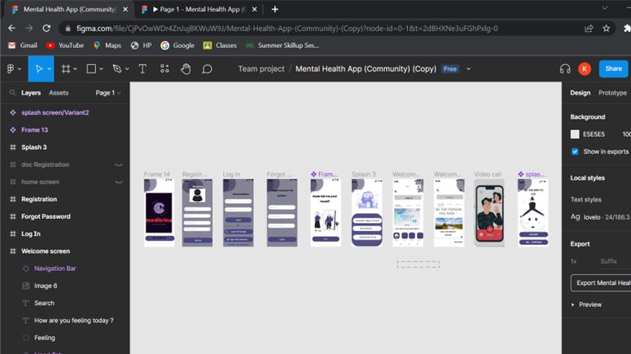
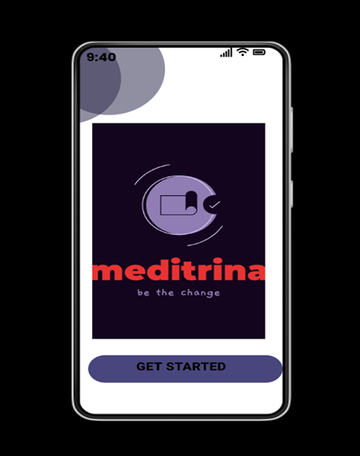
PROTOTYPE
CLICK HERE

Slide 14
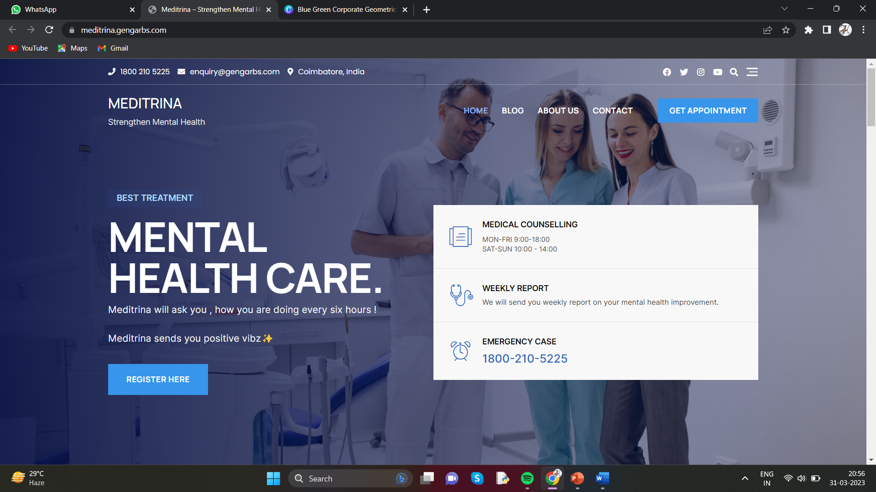
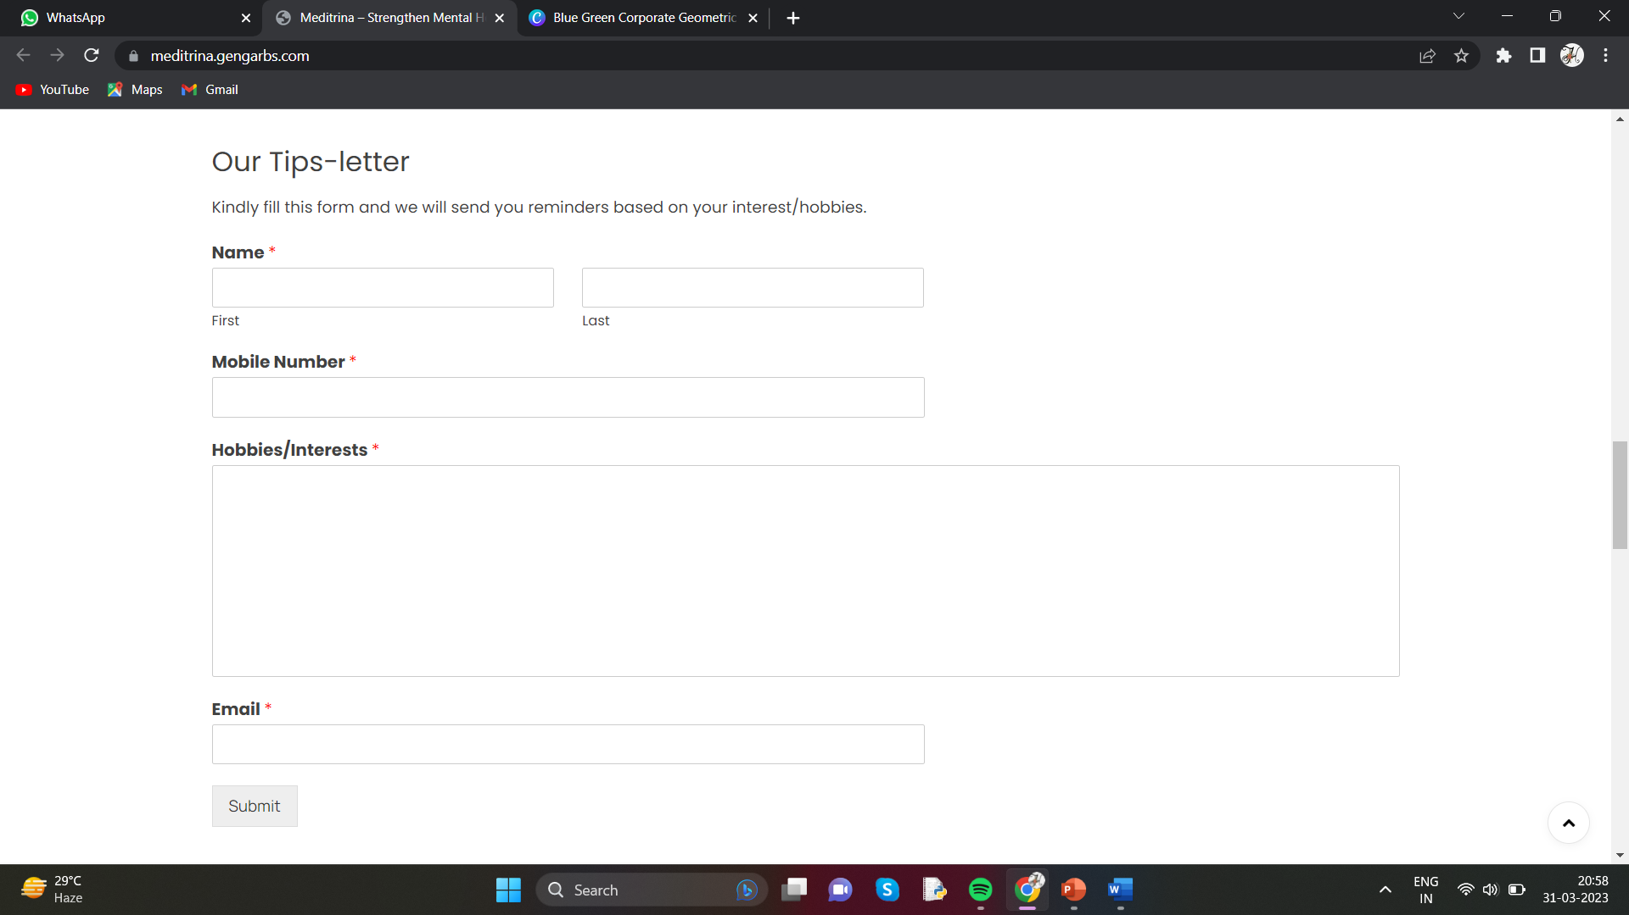
CLICK HERE

Slide 15
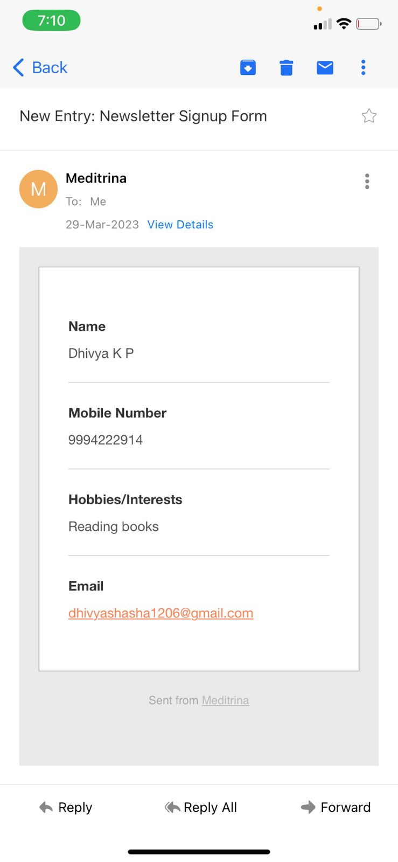
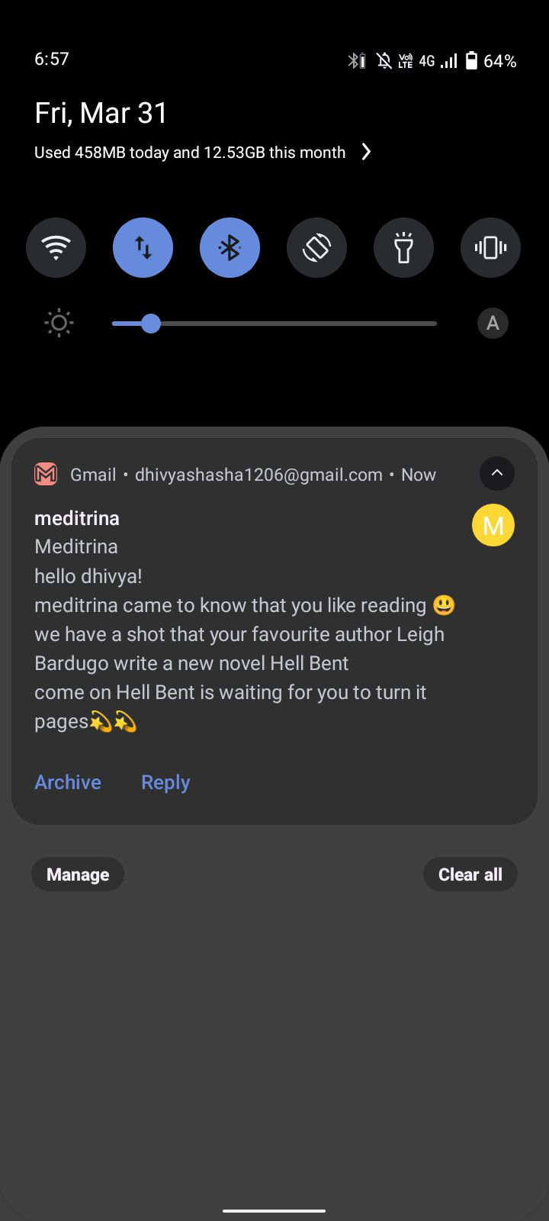
OUTPUT

Slide 16
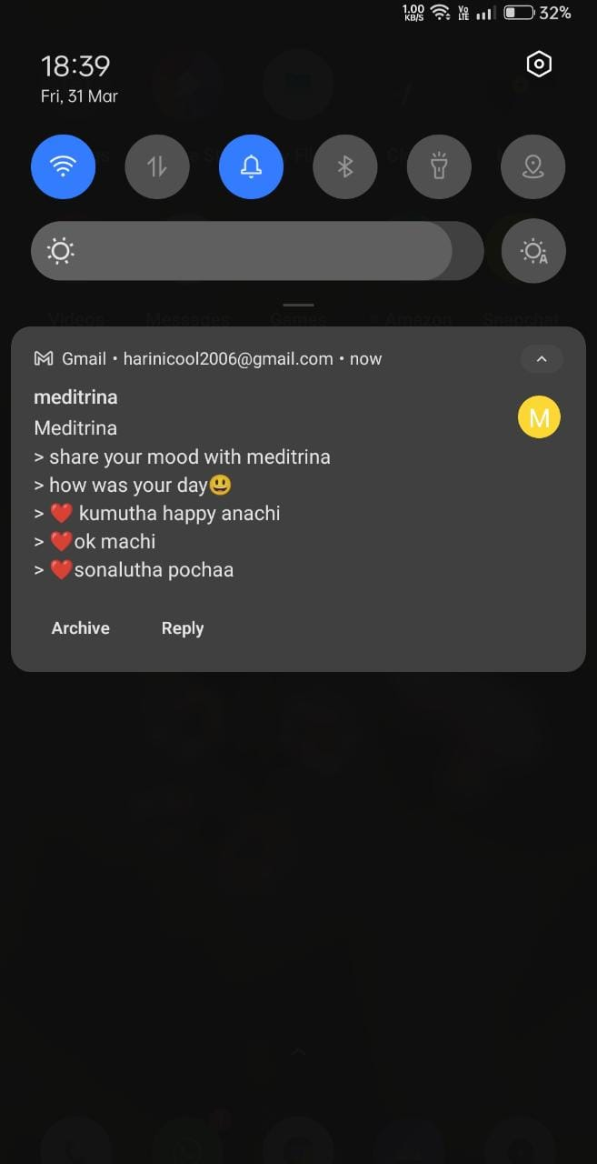
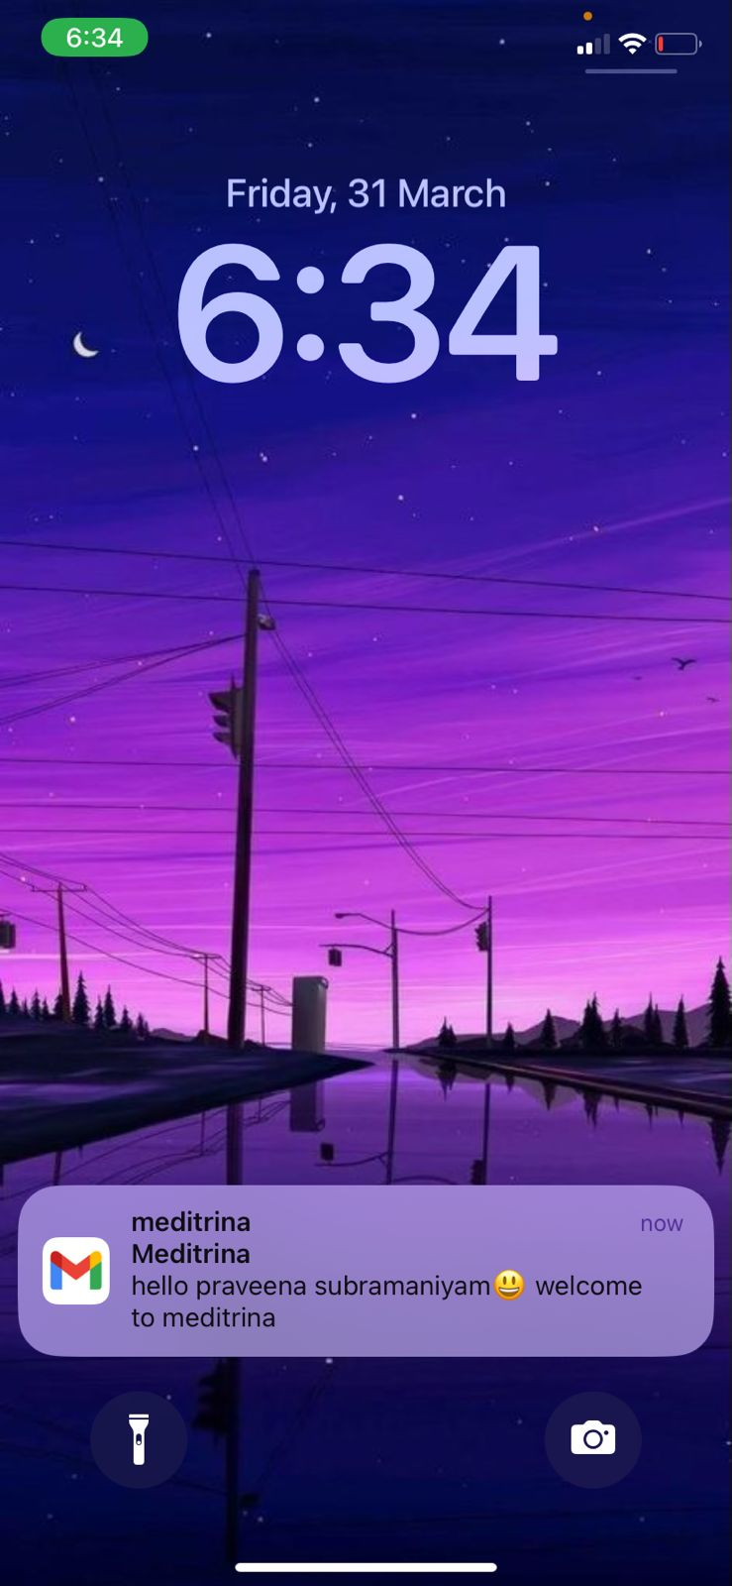
OUTPUT

Slide 17
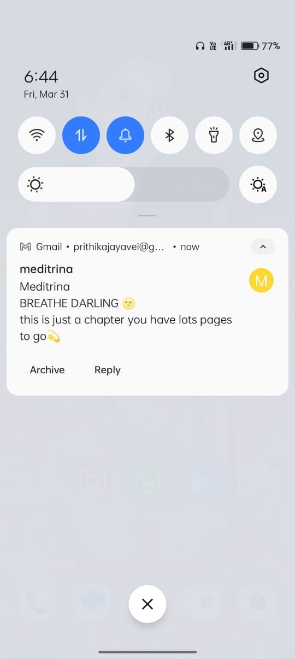
OUTPUT

Slide 18

THANK YOU!!

